Slide 1
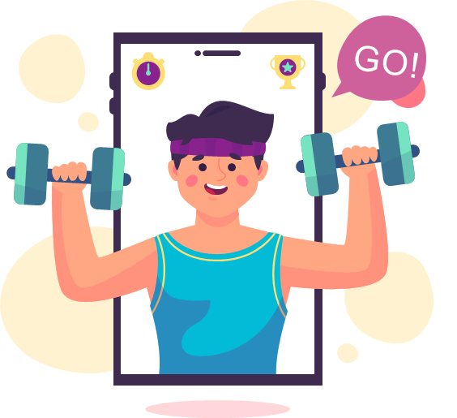
Fitness and Nutrition Buddy
Thomas Kubik, John Mistica, Cristian Trandafir, and Jayanth Podapati

Slide 2
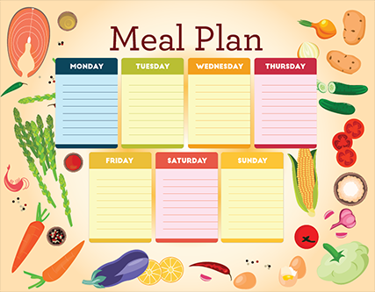

Introduction
Nutrition Tracking:
On a day-to-day basis
Meal Plan:
Filter by user’s preferences
Restaurant Search:
Location-based search
Map:
User can search for restaurants
Menu Data:
Retrieve restaurants’ menu data

Slide 3



Key Tools
Developed for Android API 31 using Android Studio
Utilized NutritionIX v2 API
Integrated Google Maps API
Firebase Cloud Firestore for Database

Slide 4
References
Hansana, Andy, et al. Chicago, IL, 2021, pp. 1–65, Fitness and Nutrition Buddy Project.

